Slide 1
Open Education & Private Education
Presented by Kayla Reed

Slide 2
Definitions & Examples
Open Educational Practices: Uses teaching and learning techniques that pull from open and participatory practices. Includes Open Educational Resources and Open Pedagogy.
Open Educational Resources: Textbooks and materials created and shared with open licenses for free sharing and use. Generally created by teaching faculty.
Grinnell example: La Princesse de Clèves by Lafayette: A New Translation and Bilingual Pedagogical Edition for the Digital Age. Edited by Hélène E. Bilis, Jean-Vincent Blanchard, David Harrison, and Hélène Visentin.
Open Pedagogy: Engages students as creators of knowledge within the classroom setting.
Grinnell example: Subcultures and Sociology website by Professor Ross Haenfler.

Slide 3
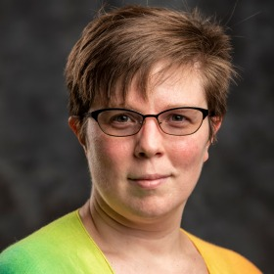
Who I am
Discovery, Systems, and Digital Strategy Librarian at Grinnell College since 2021.
Working in academic libraries since 2007.
SPARC Open Educational Leadership Program, Open Librarianship Certificate from the Open Education Network, and a Creative Commons Certificate.
Oldest child of 6 and 1st generation college student.

Slide 4
Became interested in OER while working at MSSU as Circulation Supervisor
Began an OER program at MSSU, had an ongoing committee of staff, students, and teaching faculty.
Saved the institution substantial money.
Did a lot of outreach, including videos, events, and so on!
Overall, we went from 309 impacted students in 2018 to 3,294 in 2020.

Slide 5
Changed Jobs, not interests!
Switched to Grinnell College in 2021.
Went from a Public State-funded college to a Private Liberal-Arts college.
Big culture change!
Began to wonder: How does OE fit in the private educational world?

Slide 6
Time for research! Spring 2025 Surveys
Two surveys were sent out, one to librarians and one to teaching faculty.
Survey was sent to 500 private colleges, directly to librarians and Deans.
92 total responses from Librarians.
77 total responses from teaching faculty.

Slide 7
Terms
N – Number of responses.
Resources – Stipends, Subscriptions for creation software such as Manifold.
Support- Tech support (such as training, etc), Research help from librarians, etc., Tenure and promotion guidelines that include open resources, Sabbatical time to develop materials.

Slide 8
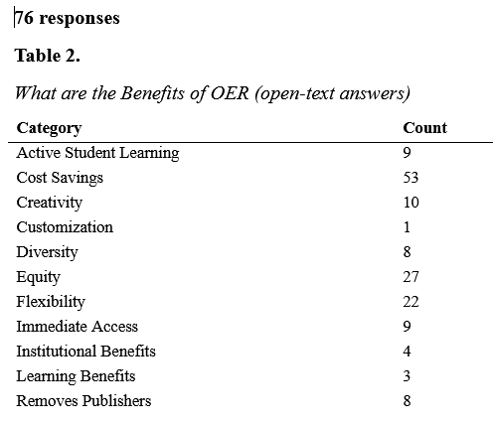
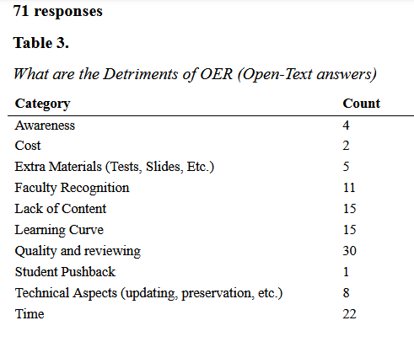
Librarian Results

Slide 9
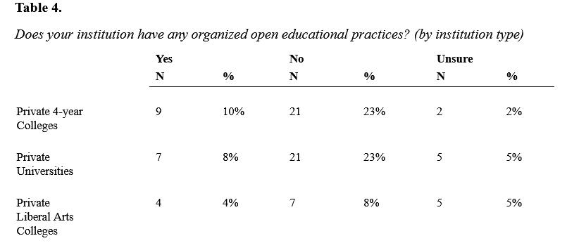
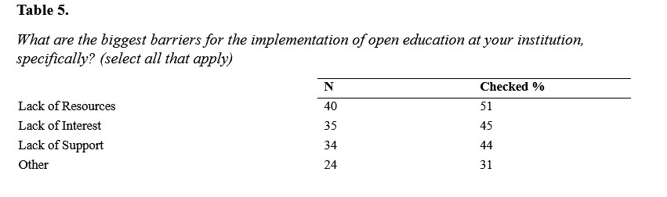
Does your institution have any organized open educational Practices? What are the barriers?

Slide 10
Other responses
Other responses included:
10 relating to time and effort.
4 stating a lack of incentives. or financial resources.
4 unrelated topics.
3 lacking relevant OER content.
2 concerning administrative support.

Slide 11
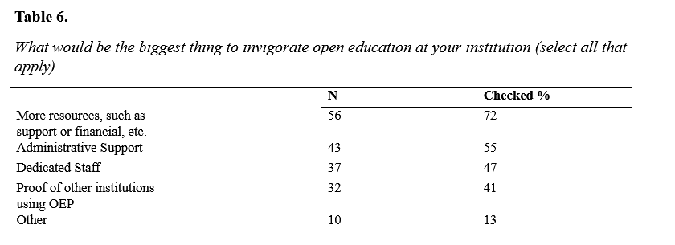
What would be the biggest thing to invigorate open education at your institution?

Slide 12
Other Responses
Other responses included:
3 comments concerning financial support, such as grants or stipends.
2 indicated the need for a way to compensate faculty time.
5 were unrelated individual institutional issues.

Slide 13
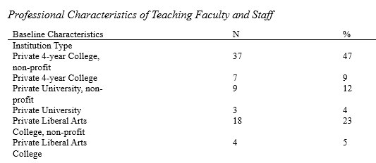
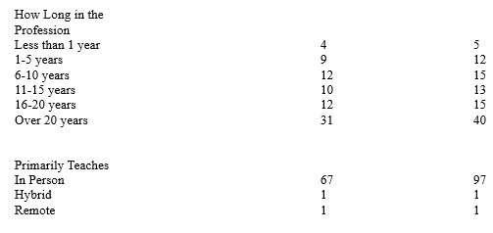
Faculty Survey Results

Slide 14
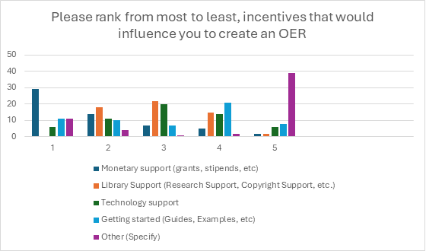

Slide 15

Other Responses

Slide 16
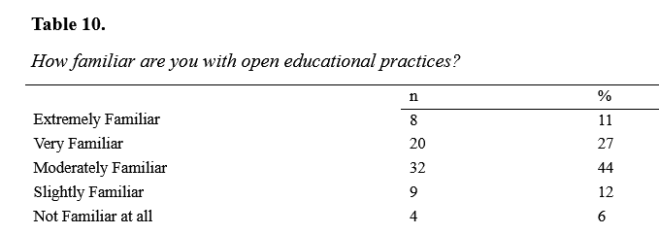
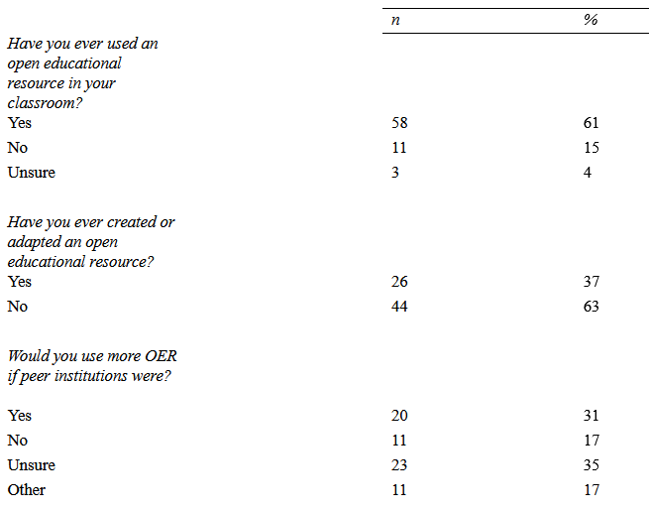
Faculty and open educational practices

Slide 17
Other responses
Most other responses indicated they are not swayed by what other professors are doing.

Slide 18
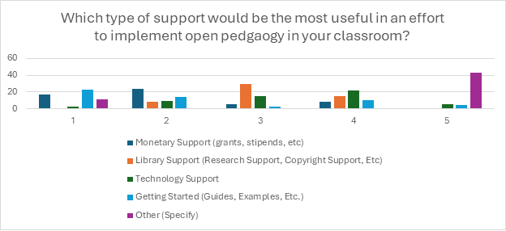
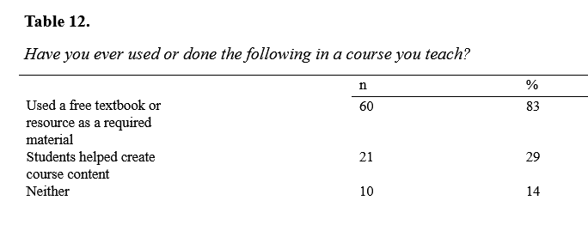
Which type of support would be the most useful? Have you ever used or done the following in a course you teach?

Slide 19
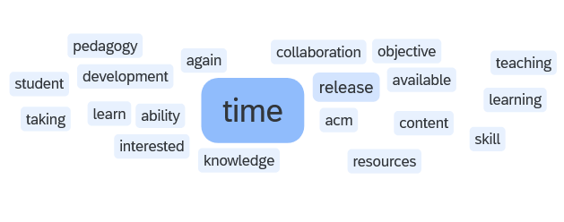
Other responses

Slide 20
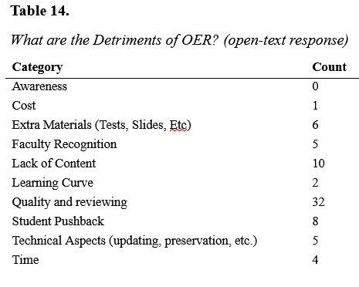
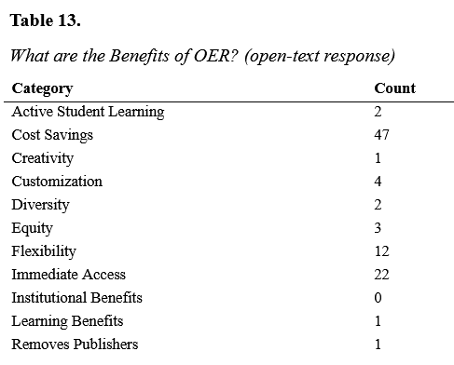
What are the benefits of OER?
What are the Detriments of OER?

Slide 21
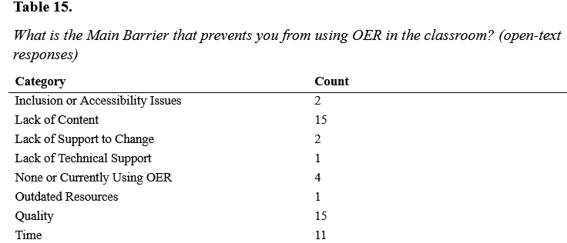

Slide 22
Interviews
Eight library worker interviews.
Five teaching faculty members.
One Senior Instructional Technologist.
Most were conducted in person.

Slide 23
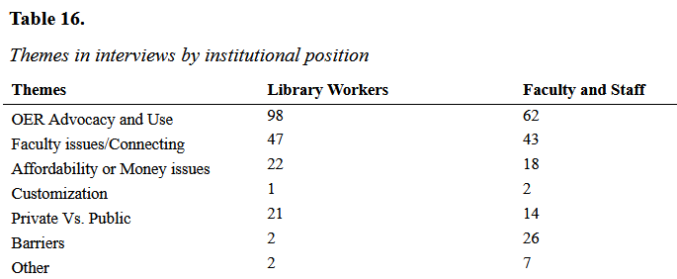
Themes coded by author

Slide 24
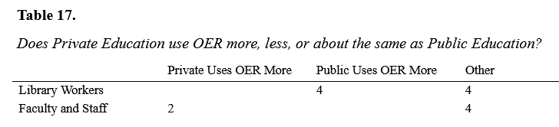
Who uses OER more?

Slide 25
The 8 Other Responses
3 of the 8 other responses felt OER usage was similar between private and public institutions.
2 respondents felt that OER usage was more varied due to differences in institution size or a focus on research versus pedagogy.
1 attributed it to private faculty having more customized courses and resources.
1 attributed it to tenure and promotion limitations.
1 attributed it to institutional wealth, with wealthy schools relying on solutions such as inclusive access contracts.

Slide 26

What did this show?
OE usage may rely on
individual
campus culture
Rather than
Private vs Public Education
More research needed!

Slide 27
Other Issues:
Privacy and Data: Certain materials are sensitive and should not be open to the public.
Accessibility costs money.
Individual departments decide how open publishing counts.
Support!

Slide 28

Open Pedagogy Toolkit
Created this site as part of my research to help inform and improve the open pedagogy creation process.

Slide 29

Future directions
Learning outcomes with Open Practices: Is there a difference?
Equity in Open Educational Practices, especially disability services.
Open Pedagogy impacts on student learners.

Slide 30
Questions? Thank you!
Kayla Reed
reedkayla@grinnell.edu

